Slide 1
1.1 Digital System
By: NIRJAL MAHARJAN
022BSCIT024@sxc.edu.np
2023/02/13

Slide 2
Contents
Introduction to Digital System 3-4
Digital and analog system 5-6
Block diagram of digital computer 7-8
Advantage of digital system 9
Disadvantages of digital system 10

Slide 3
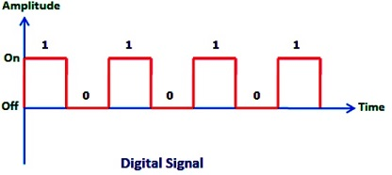
Introduction to Digital System
A set of things working together as parts of a mechanism or an interconnecting network; a complex whole is called system.
Digital systems are designed to store, process, and communicate information in digital form.
The digital computers we commonly use for general purpose is best-known example of a typical digital system.
Digital systems are all around us in the form of computers, smartphones, scanners, cash registers and digital ticket readers.
Characteristics of digital system is use of discrete elements of information.

Slide 4
Introduction to Digital system (continued..)
The basic blocks of a computer are the central processing unit (CPU), the memory, and the input/output (I/O).
The CPU of the computer is basically the same as the brain of a human.

Slide 5
Digital and Analog system
What is an Analog System?
A system that uses continuous time signal for processing is known as an analog system. The analog signals or continuous time signals are the signals whose magnitude continuously changes with time. Most analog systems use continuous time signals having sinusoidal waveforms.
Analog systems are much faster in comparison to digital systems because these systems accept the signals in their original form, and hence there is no need of signal transformation. However, the data transmission through analog systems is badly affected by electronic noise during transmission.
Another major drawback of analog systems is that they consume more power as compared to digital systems. These days, analog systems are not so frequently used in general purpose applications, though they are still used in specialized applications.

Slide 6
Factor | Digital System | Analog System
Signal Type | Digital Systems use discrete signals as on/off representing binary format. Off is 0, On is 1. | Analog Systems use continuous signals with varying magnitude.
Wave Type | Digital Systems use square waves. | Analog systems use sine waves.
Technology | Digital systems first transform the analog waves to limited set of numbers and then record them as digital square waves. | Analog systems records the physical waveforms as they are originally generated.
Transmission | Digital transmission is easy and can be made noise proof with no loss at all. | Analog systems are affected badly by noise during transmission.
Flexibility | Digital system hardware can be easily modulated as per the requirements. | Analog system's hardware are not flexible.
Bandthwidth | Digital transmission needs more bandwidth to carry same information. | Analog transmission requires less bandwidth.
Cost | Digital systems are costly. | Analog systems are cheap.
Examples | Examples : Computers, CD, and DVD. | Examples : analog electronics, voice radio using AM frequency.

Slide 7
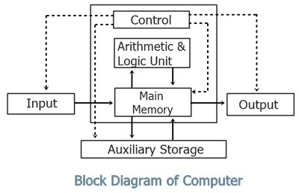
Block Diagram of Digital Computer
Computer System mainly consists of three parts, that are central processing unit (CPU), Input Devices, and Output Devices.
The Central Processing Unit (CPU) is divided into two parts again: arithmetic logic unit (ALU) and the control unit (CU). The set of instruction is in the form of raw data.
A large amount of data is stored in the computer memory with the help of primary and secondary storage devices.
The user does not get the desired output, without the necessary option taken by the CPU.
The Central processing unit (CPU) is responsible for the processing of all the instructions which are given by the user to the computer.
The data is entered through input devices such as the keyboard, mouse, etc. This set of instruction is processed by the CPU after getting the input by the user, and then the computer system produces the output showed by output devices.

Slide 8
Block Diagram of Digital computers

Slide 9
Advantages of Digital System:
Have made possible many scientific, industrial, and commercial advances have been unattainable otherwise.
More reliable.
Easy to manipulate.
Flexibility and compatibility.
Information storage can be easier in digital computer systems than in analog ones.
New features can be added to a digital system more easily too.

Slide 10
Disadvantages of digital system:
Uses more energy than analog circuits to accomplish the same tasks.
Digital circuit are often fragile, in that if a single piece of digital data is lost or misinterpreted the meaning of large blocks of related data can completely change.
Digital computer manipulates discrete elements of information by means of a binary code.
Quantization error during analog signal sampling.

Slide 11
Thank You
NIRJAL MAHARJAN
022BSCIT024@sxc.edu.np

